Slide 1
How to do machine learning research
by Bill Freeman, Andrej Karpathy, Eamonn Keogh
Summarised by
Markus Heinonen, Aalto University
March 2023

Slide 2
http://people.csail.mit.edu/billf/publications/How_To_Do_Research.pdf
Bill Freeman, MIT
~90,000 citations

Slide 3
Please don’t tell me “it doesn’t work”. Of course it doesn’t work
What I want to hear instead is something like, “I’ve narrowed down the problem to step B. Until step A, you can see that it works, because you put in X and you get Y out, as we expect. You can see how it fails here at B. I’ve ruled out W and Z as the cause.”
Take things slowly. Verify your assumptions. Understand the thing, whatever it is–the program, the algorithm, or the proof. As you do experiments, only change one thing at a time, so you know what the outcome of the experiment means.

Slide 4
Slow down to speed up
I love to hear about progress when I meet with students, but note that I have a very general notion of progress. Progress can include: “I’ve shown why this doesn’t work”, “I’ve simplified the task to get it to start working.”, or “I spent the whole time reading because I know I have to understand this before I can make any progress.”
The weak student does exactly what the advisor has asked. But the advisor’s solution fails, and the student reports that failure.
The strong student starts doing what the advisor has asked, sees that it doesn’t work, looks around within some epsilon ball of the original proposal to find what does work, and reports that solution.

Slide 5
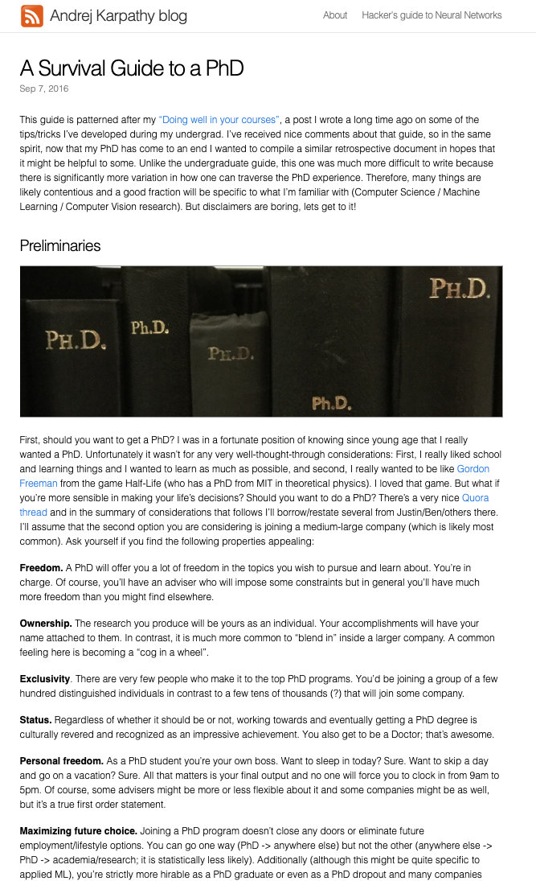
Andrej Karpathy, Tesla
~55,000 citations
http://karpathy.github.io/2016/09/07/phd/

Slide 6
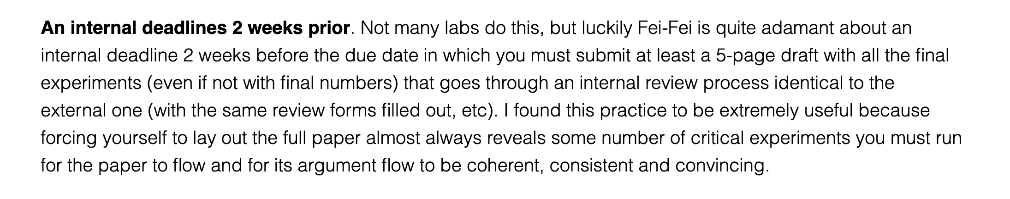
Finishing papers

Slide 7
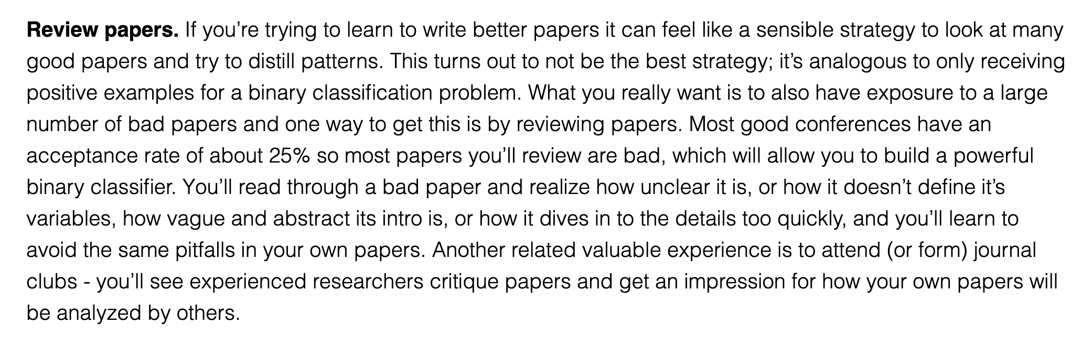
How to write good papers

Slide 8
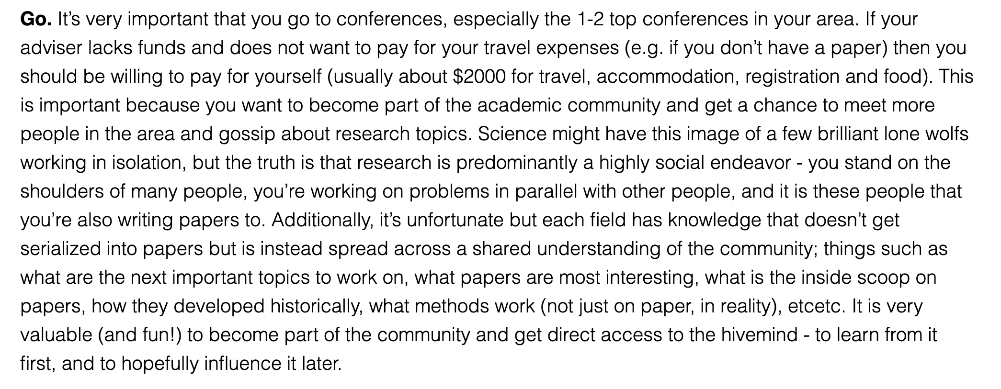
Conferences

Slide 9
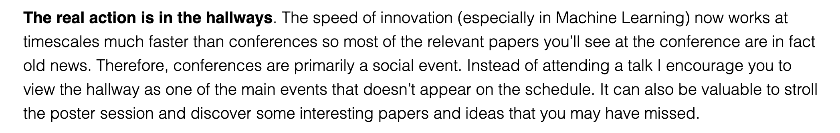
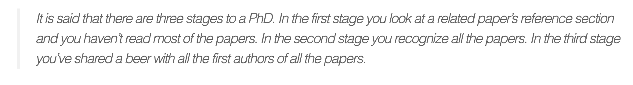
Conferences

Slide 10
http://www.cs.ucr.edu/~eamonn/Keogh_SIGKDD09_tutorial.pdf
Eamonn Keogh, UC
~55,000 citations

Slide 11
Finding research problems

Slide 12
Problem statement

Slide 13
First page as an anchor

Slide 14
Eliminate simple ideas first

Slide 15
Don’t make reviewers think!
👎
👍

Slide 16
👎
👍

Slide 17
Reproducibility

Slide 18
Use color

Slide 19
Too many digits

Slide 20
Be precise

Slide 21
Report performance distribution

Slide 22
Report performance distribution
👎
All of these hide information

Slide 23
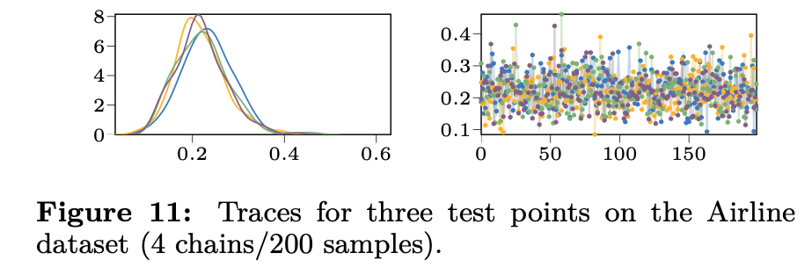
Show your distributions!
Show both of these
👍

Slide 24
My recommendations

Slide 25
Recognize sources of variability
Always give some variance of all quantities (eg. accuracy)
At least six sources of variability
Test distribution
Function stochasticity
Parameter posterior
Parameter initialisations
Hyperparameters
Training samples
Random seed
A good paper demonstrates how the model behaves wrt all sources
$$Ε_{x∼p\left(X_{test}\right)}f\left(x | θ,ε\right)p\left(θ | θ_{0}, γ, X_{train}, seed\right)$$

Slide 26
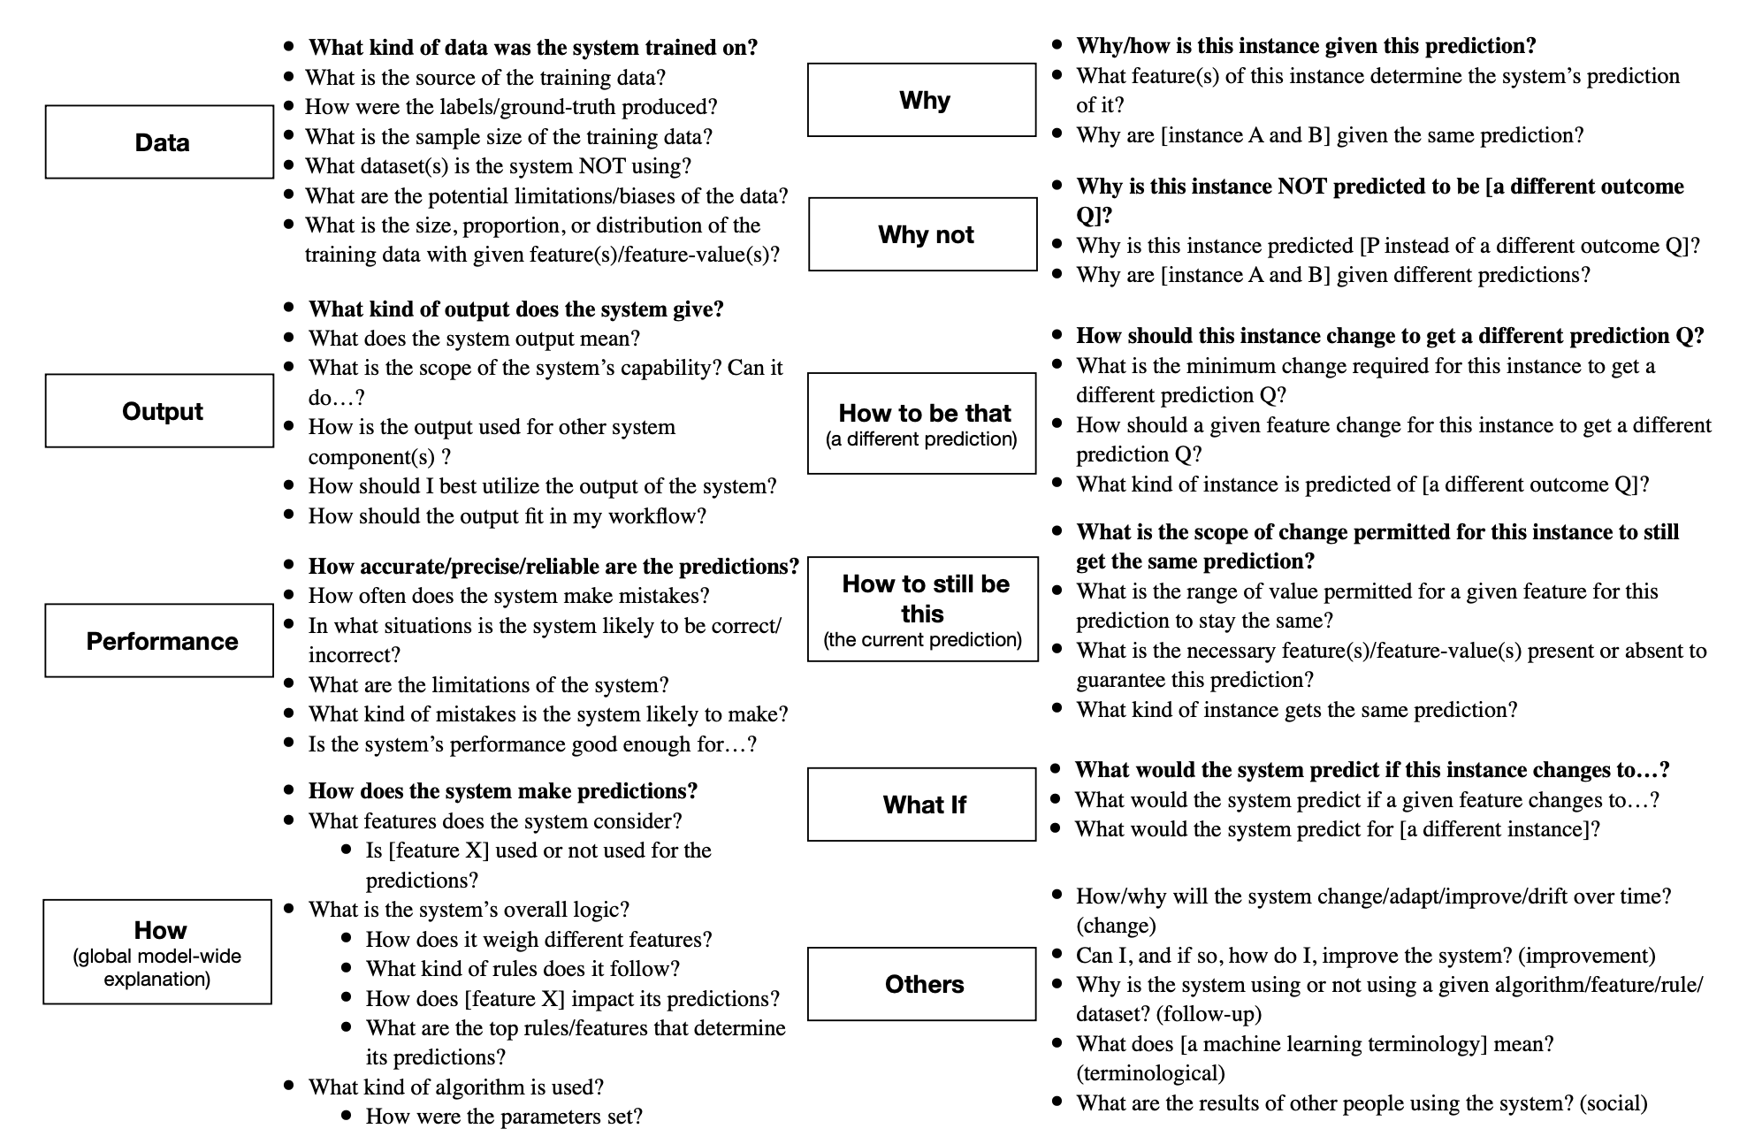
Do you understand your model? .. does your audience? .. do your reviewers?
🤔
Liao, Gruen, Miller. Questioning the AI: Informing Design Practices for Explainable AI User Experiences, 2020

Slide 27
Two scenarios
Students runs an experiment and gets great results, but doesn’t know why
Student runs an experiment and gets bad results, and doesn’t know why
Which one is better?
Both are bad!

Slide 28
Standard for publications is high!

Slide 29
On being precise
Sloppy presentation implies that you don’t care about your work
Typos, mistakes, poor illustrations, missing citations
Typos signal that you did not bother to proofread your paper
Fair enough, I won’t bother to read your paper either
There can not be any mistakes in math
If you don’t understand the equations, why should the reader bother?

Slide 30
Giving talks
Don’t target your talk to experts of your domain
They have already read your paper; they will cite you anyways
Target your talk to non-experts
Conferences are a place to hear about new things
The audience has a limited mental budget
The listener has to build a mental model of every equation
60% of people are visual learners
Visualise all math: If you can’t, can the audience?
Don’t make audience think
Color your math
After 5 equations or symbols half the people will stop listening
Is all of your math crucial for understanding?
Can you replace math with figures?

Slide 33
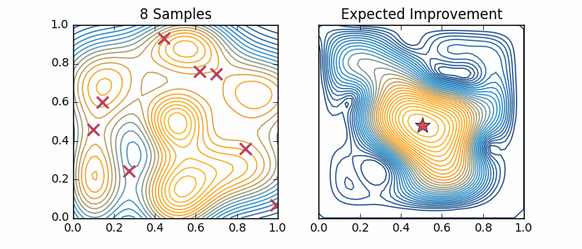
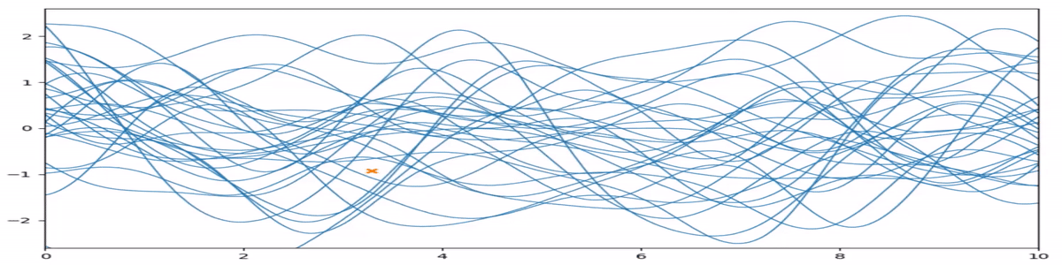
Animate your presentations! The math of this slide can be almost understood with no math!
👍

Slide 34
Wide aspect ratio looks nicer \documentclass[aspectratio=169]{beamer}
👍

Slide 35
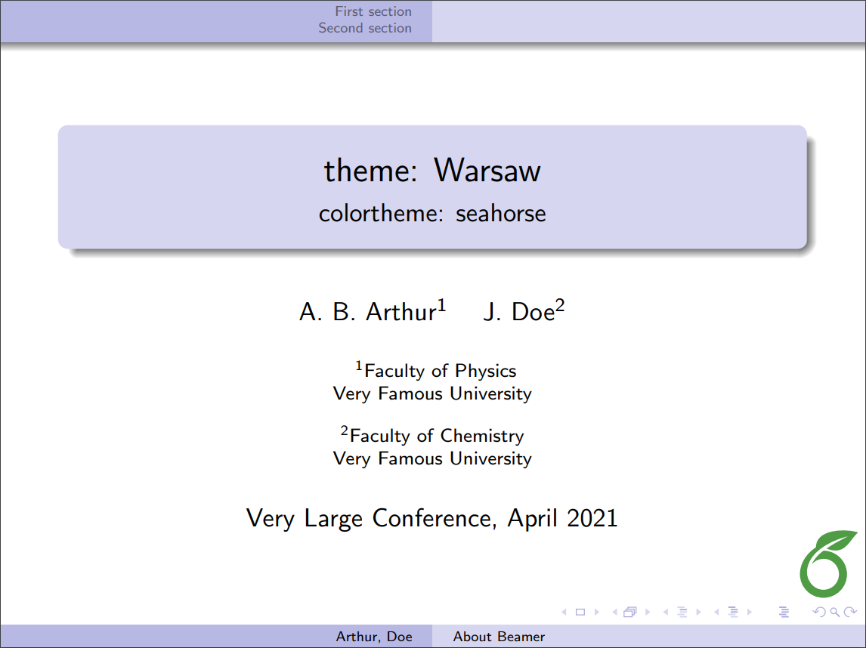
Remove unnecessary stuff

Slide 36
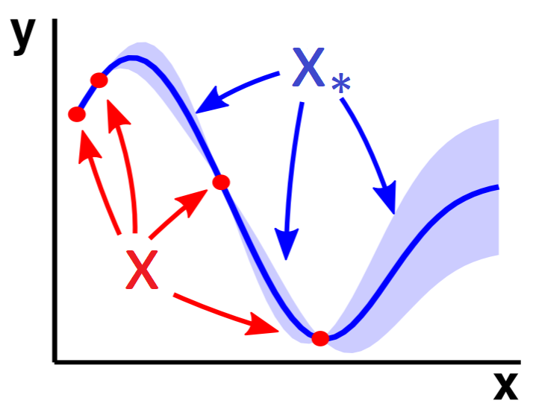
Annotate plots Help the reader!
👍

Slide 37
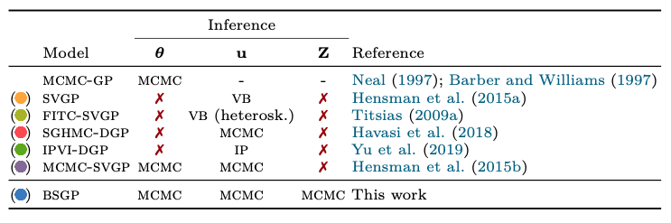
Include scope table Define the context!
👍
(colors help a lot!)

Slide 38
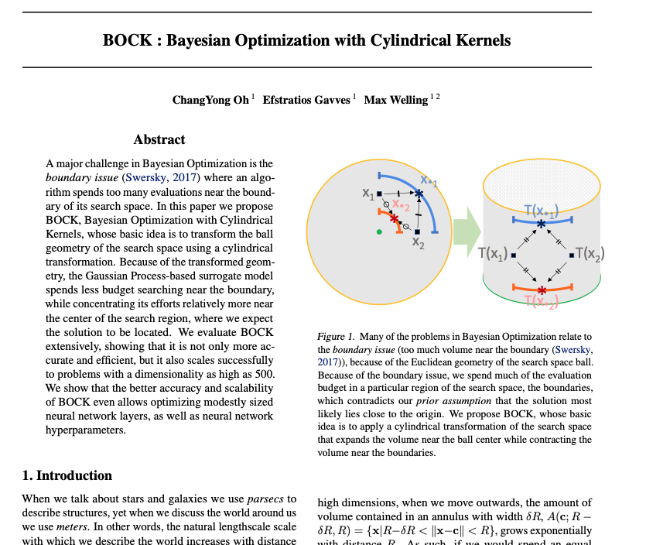
Use a first-page figure (but what kind…)
👍

Slide 39
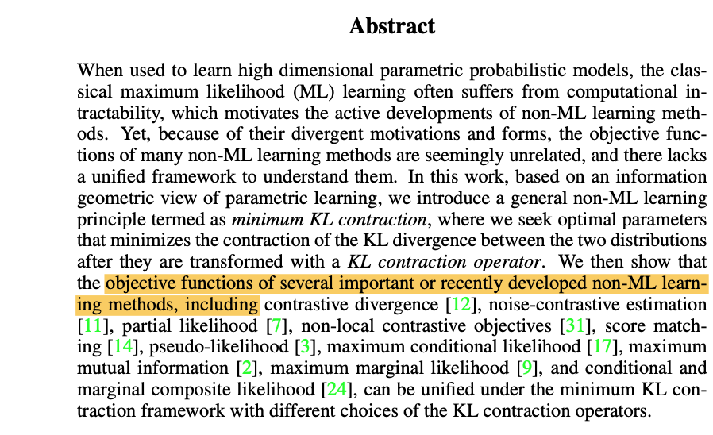
You can break article conventions
🤔
Citations in abstract, why not
Literature survey can come late
Math on second sentence is fine

Slide 40
A good paper tells a story

Slide 41
Tips for paper structure
Title can be conclusive or descriptive
Prefer interesting and thought provoking titles
Short introduction that establishes the problem (2 paragraphs)
Keep to the main message
Only include references that are relevant for your problem
First page figure that sells the message
Place “related works” section after results
Use lots of subheadings (the paragraph format is ideal)
Headings should be conclusions or questions

Slide 42
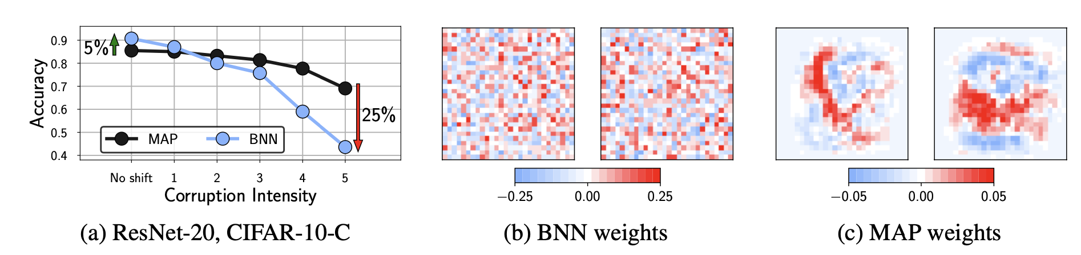
First figure
Always have an informative first figure that ideally
Establishes the problem
Describes the idea of the solution

Slide 43
Make math easy to understand

Slide 44
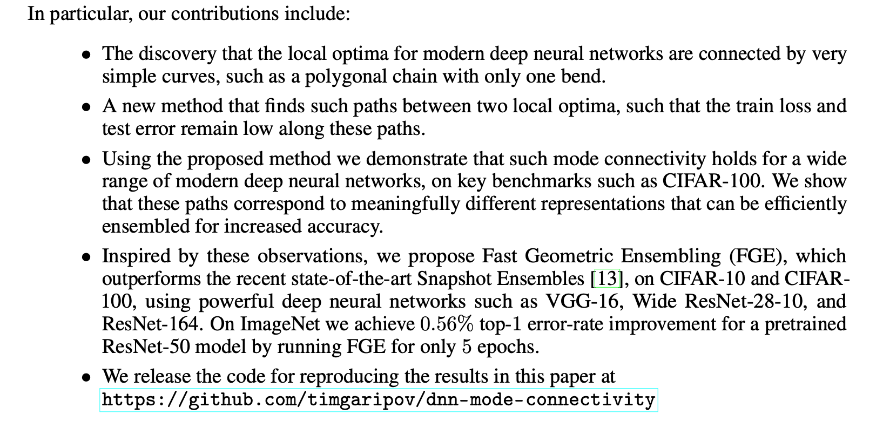
Bullet your contributions (reviewers are asked to list them, don’t make them think)
Don’t forget this

Slide 45
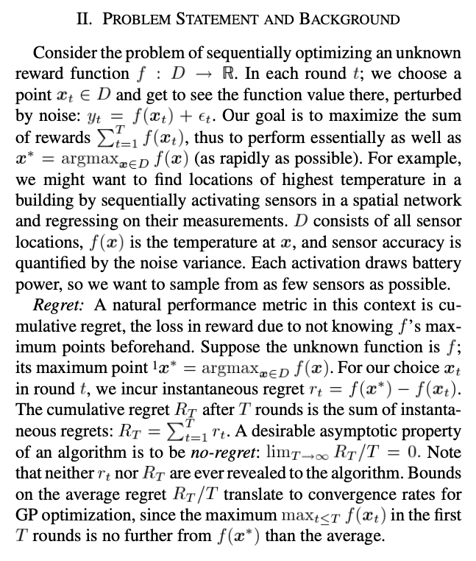
Define your problem
👍
Precise goal
Conceptualise
Define unknowns

Slide 46
Visualise the obvious
👍

Slide 47
High-level schematics
👍

Slide 48
Technical schematics: map your math (also separate how model use differs between train/test)
👍

Slide 49
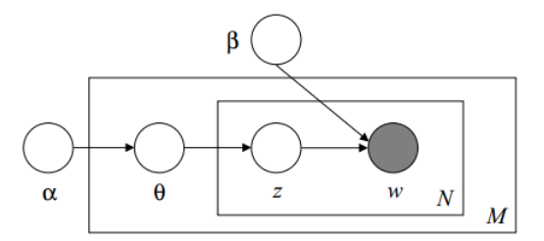
Are you probabilistic? Then do a plate diagram
👍

Slide 50
Clear result tables \includepackage{booktabs}
👍
Eyes naturally compare things vertically, but can’t compare horizontally
Use color
(but be consistent)
(don’t forget variances!)

Slide 51
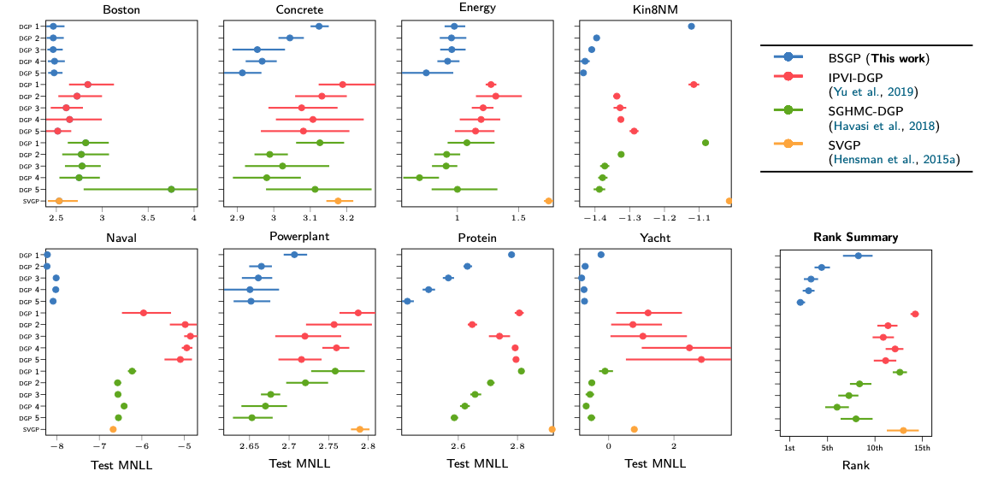
Presenting large comparisons
👍
Summarise!

Slide 52
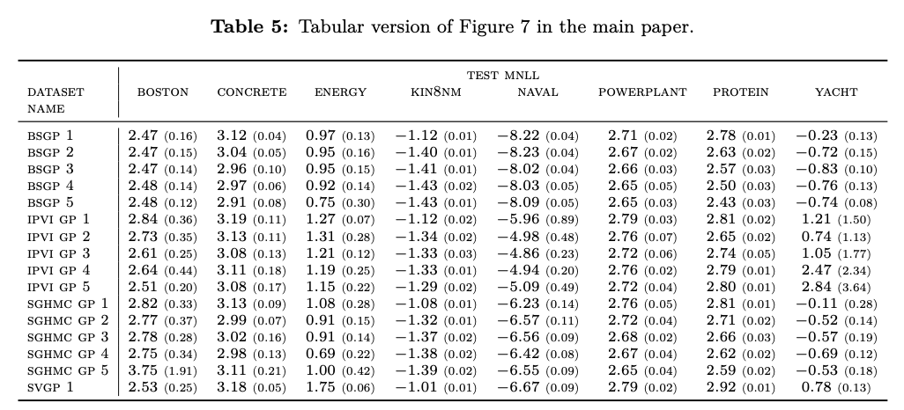
Presenting large comparisons
👍
Put tabular copy to appendix!
Std with smaller font 👍

Slide 53
Visualise intermediate fits
👍

Slide 54
Ablation studies
👍

Slide 55
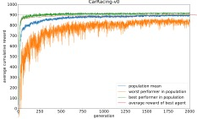
Learning curves over data / folds / ensembles / terms
👍

Slide 56
Include “dummy” baselines
👍
( too many digits! )

Slide 57
Parameter & feature tables
👍

Slide 58
Start every project with PCA / T-SNE / UMAP
👍

Slide 59
Visualise loss landscapes or posteriors
👍
https://arxiv.org/abs/1712.09913

Slide 60
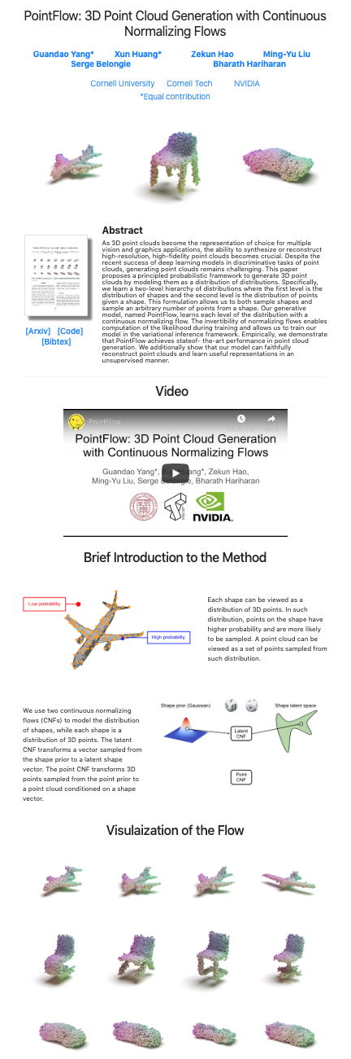
Build your brand
Have a twitter/blog/github/scholar/website
Make sure collegues/journals/conferences/bigshots can find you online
Build a website for each paper
Include code / examples / visualisations
Arxiv is not enough
Include a “1-click” demo
Website increases impact and reach

Slide 61
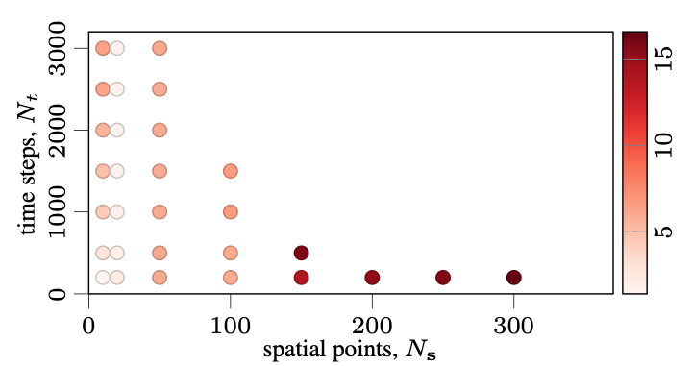
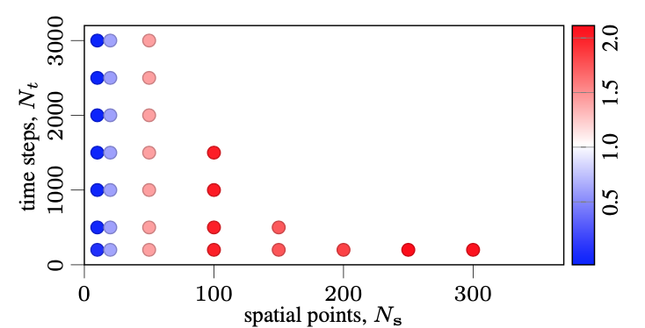
On plotting
Seaborn and matplotlib are good libraries
Use soft color (the “CN” colors in matplotlib)
Don’t use “r/b/g/c/k” colors
Use red-white-blue for two-sided colors
Save images as .png with high dpi 600
Vector formats .pdf/.eps are a headache
Trim all whitespace with imagemagick -trim
Scale figures to be readable with poor eyesight
Make everything way bigger than you think!
Decrease ‘figsize’ to scale the figure (use smallest figsize that looks good)
Don’t adjust fonts manually
All figure fonts need to be as big as caption font
Figures need to be self-contained and self-explanatory
Does the figure work without caption? If not, simplify!
Caption: give conclusion

Slide 62
On captions
🤔
Is the plot self-explanatory without the caption?
description
conclusion
Is the plot fully labelled?
👎

Slide 63
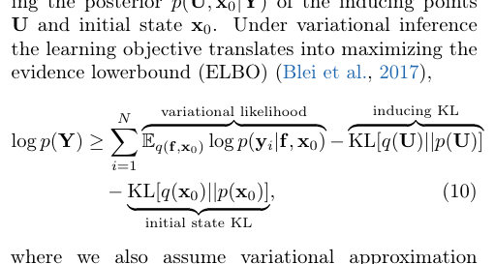
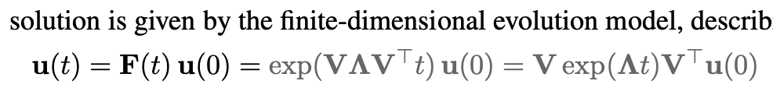
On Latex
👍
Try to keep to classic latex style
Basics
Use booktabs for tables
Use \resizebox to make tables exactly 1-column wide or 2-column wide
Use natbib with \citep and \citet
Color citations blue, eqrefs red
\usepackage[usenames,dvipsnames]{xcolor}
\usepackage[colorlinks=true,citecolor=MidnightBlue]{hyperref}
Math
Use \align
Don’t place line breaks around equations
Don’t place whitespace around parenthesis (don’t use \left( if not needed)
Use big parentheses a lot
Use \underbrace a lot!
Use macros, eg. \def\N{\mathcal{N}}
Use color
Math presentation
Prioritize readability and understandability
Include full math and intermediate derivations in appendix

Slide 64
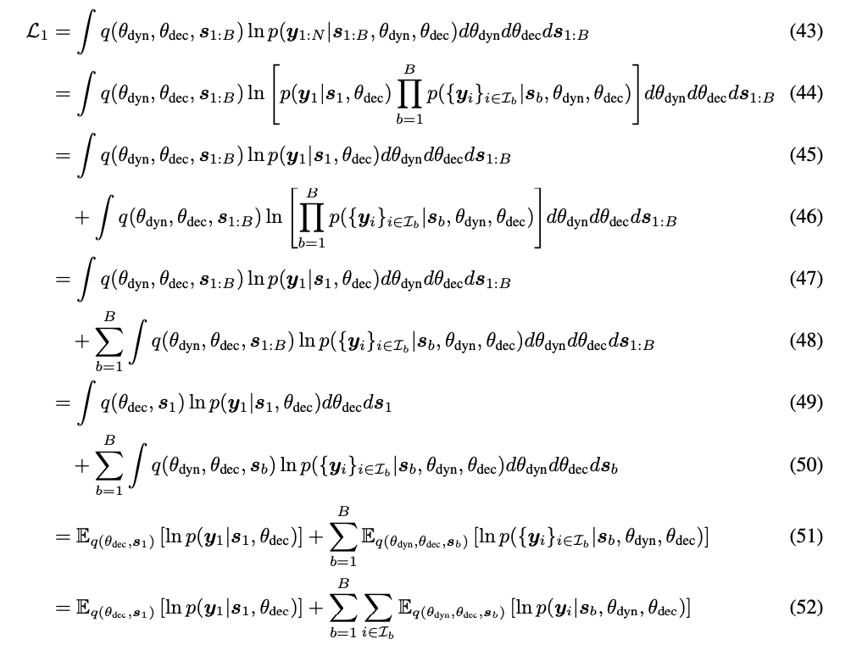
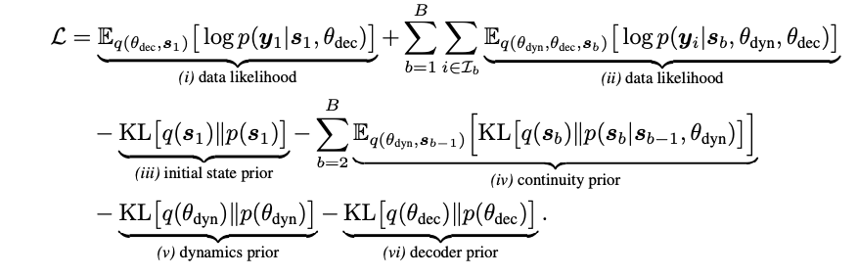
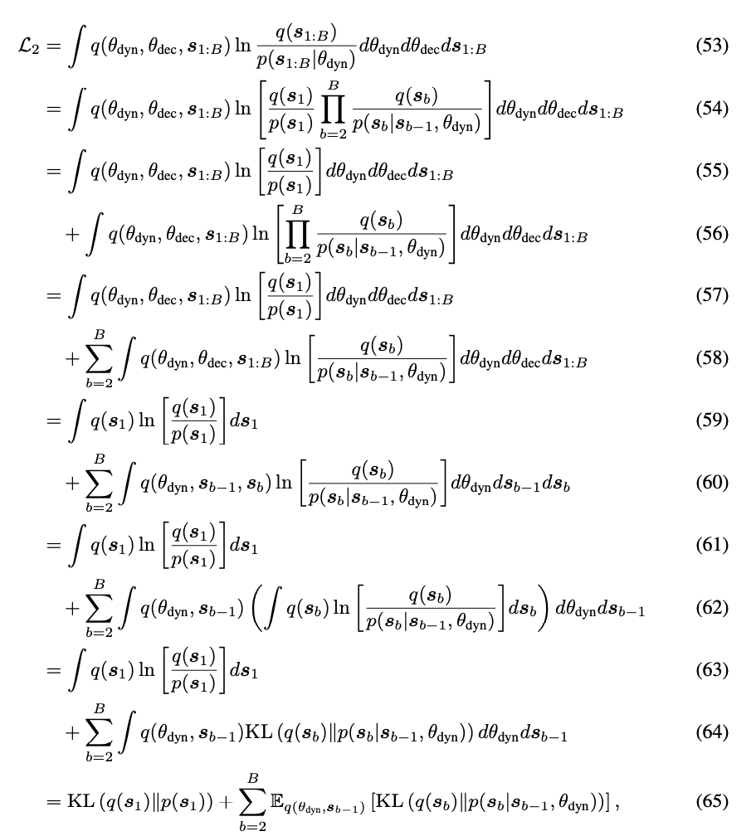
Complex math Gist in main text, details in appendix
Annotate

Slide 65
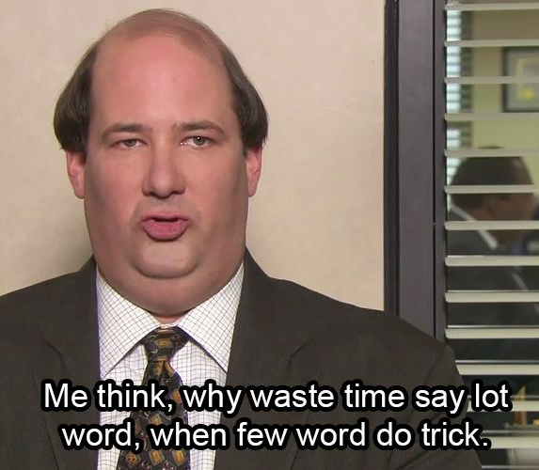
Remove unnecessary words that you don’t need in sentences.
because based on the fact that
for the purpose of
there were several subjects who completed
it is suggested that a relationship may exist
a total of n subjects
four different groups
the reason is because
The results showed that
https://www.sportsci.org/jour/9901/wghstyle.html

Slide 66
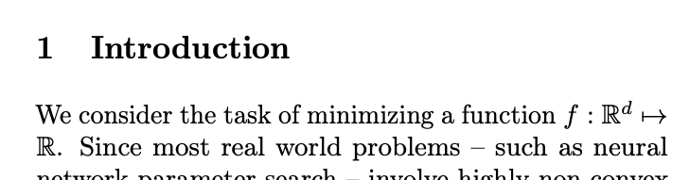
Go to the point

Slide 67
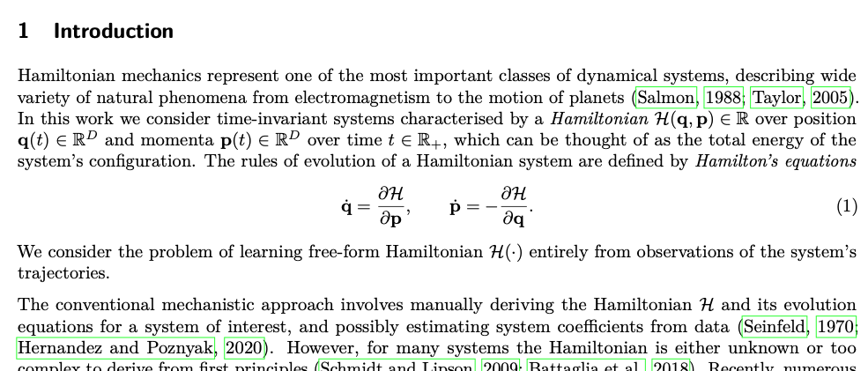
Go to the point
Context
Setting
Problem

Slide 68
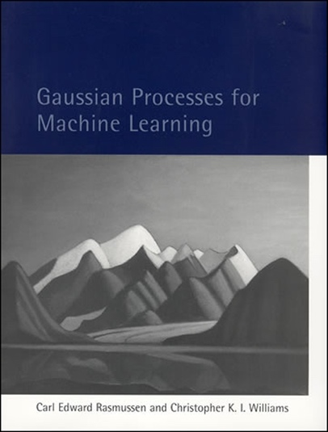
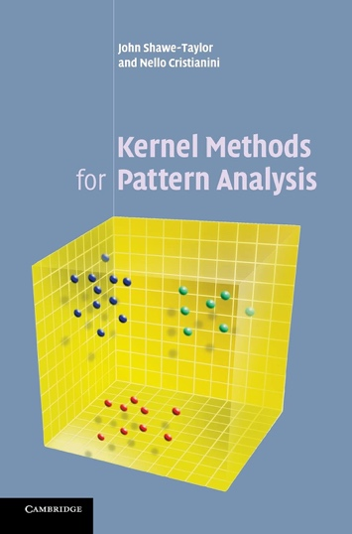
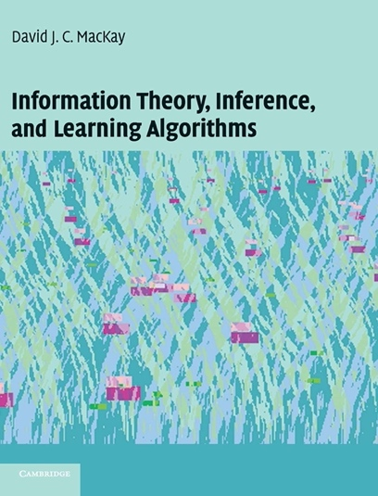
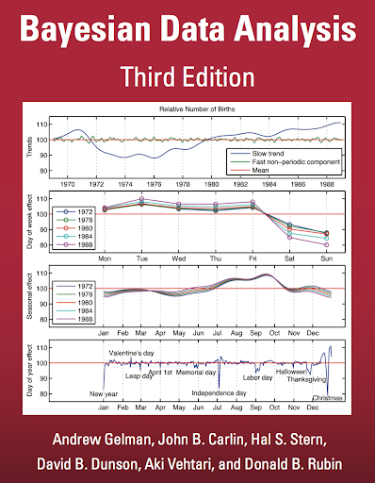
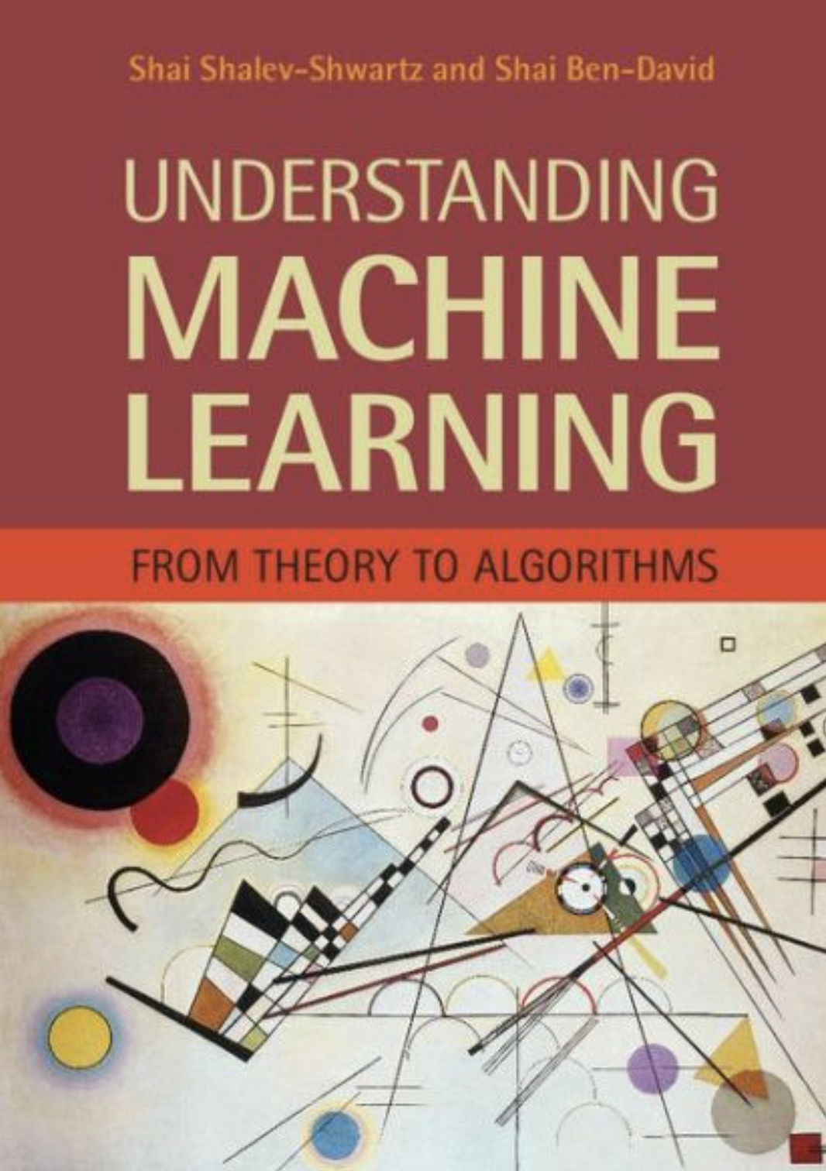


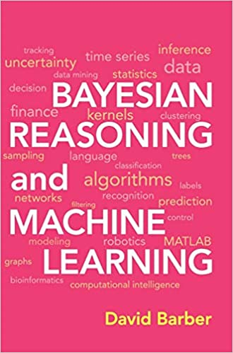
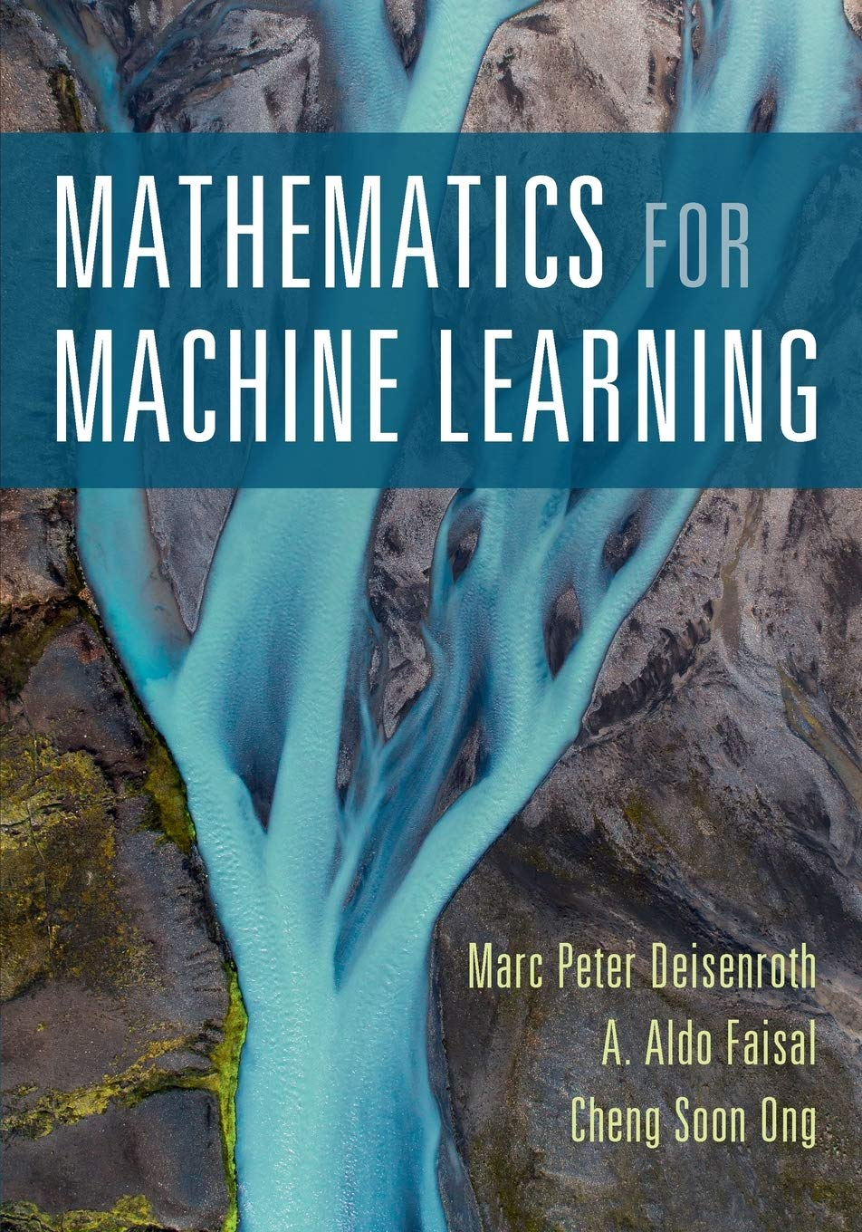
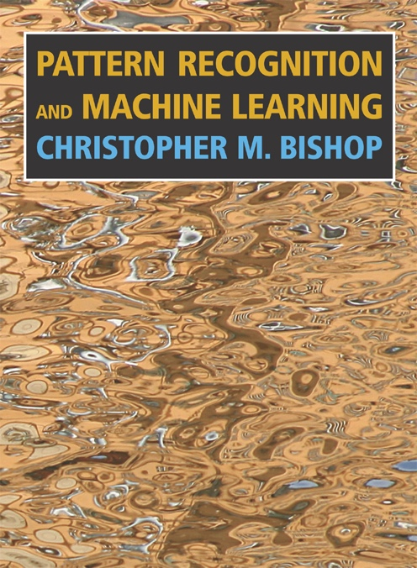
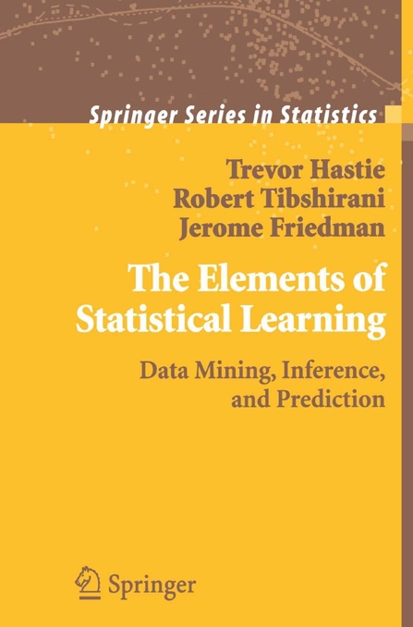
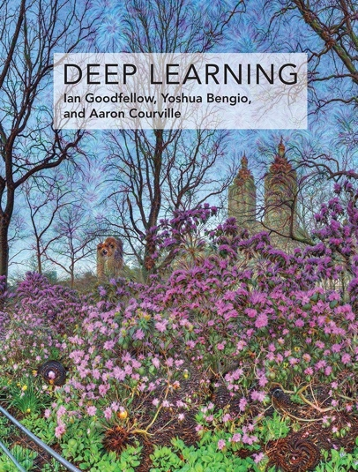
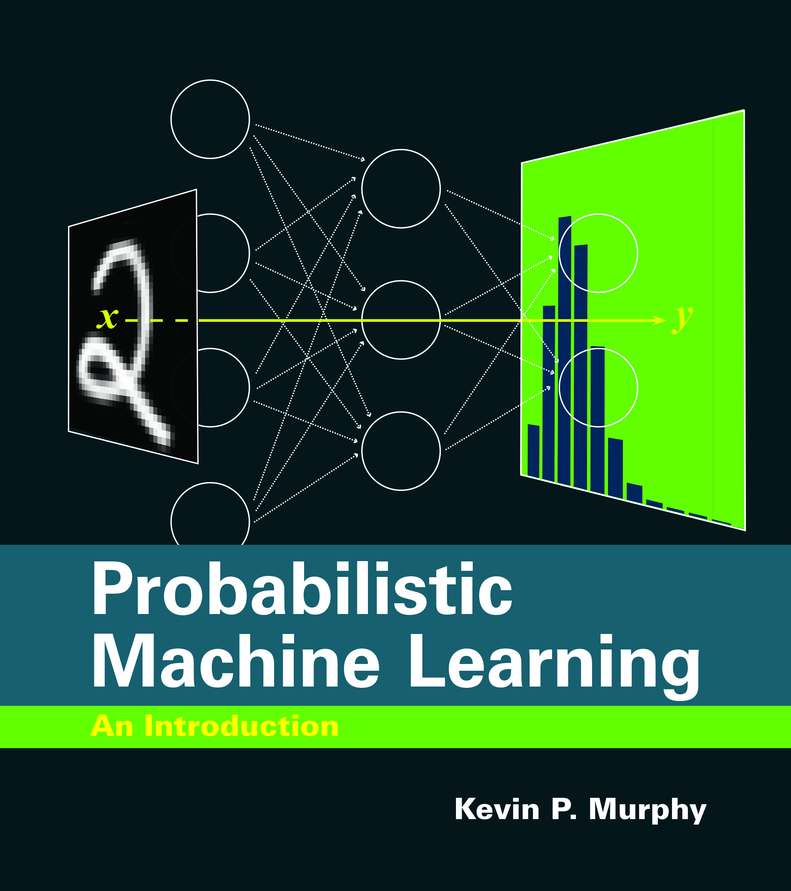
On reading
Only an ML expert can create new ML
Become an expert
In the first 12 months of your phd
Read Math for ML
Read PRML or ESL
Read Deep Learning or PML
(lots of overlap!)
Use 8 hours a week to read
If you get stuck, read more (not less!)
Main result of phd is you, not your research!
1st year

Slide 69
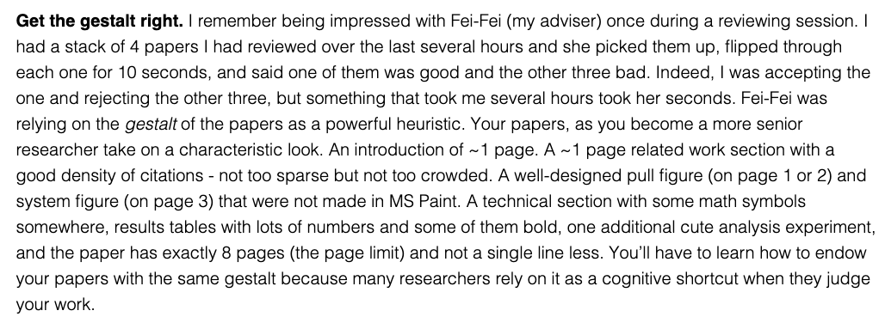
How to read a paper?
Do you understand the gist of the paper?
Often 10 minutes is enough
Could you reproduce the paper?
Takes hours or days
In most papers getting the gist is enough

